Slide 1
Module 1part 1

Slide 2
PC System Components
Lessons
  PC Hardware
  Motherboard
  Expansion cards
  Memory
  Processor

Slide 3
PC Hardware
Topics
  Introduction to PC
  BIOS Settings
  Hardware Components
  Custom Configuration
Introduction
  To perform a computing task, software uses hardware for four basic functions: input, processing, storage, and output. Also, hardware components must communicate both data and instructions among themselves, which requires an electrical system to provide power, because these components are electrical.

Slide 4
PC Hardware
Topics
  Introduction to PC
  BIOS Settings
  Hardware Components
  Custom Configuration
Introduction
  To perform a computing task, software uses hardware for four basic functions: input, processing, storage, and output. Also, hardware components must communicate both data and instructions among themselves, which requires an electrical system to provide power, because these components are electrical.

Slide 5
Introduction to PC

Slide 6
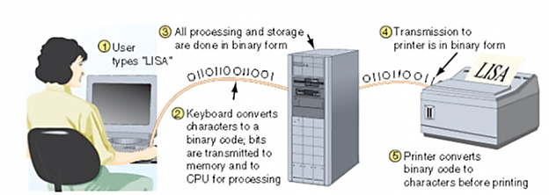
Binary number system
In a computer, all counting and calculations use the binary number system

Slide 7
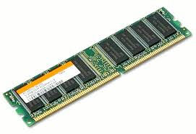
RAM
RAM -Some motherboards can use different types of RAM, such as parity and non-parity, or different speeds, and the CMOS Setup program may provide the opportunity to change those settings.

Slide 8
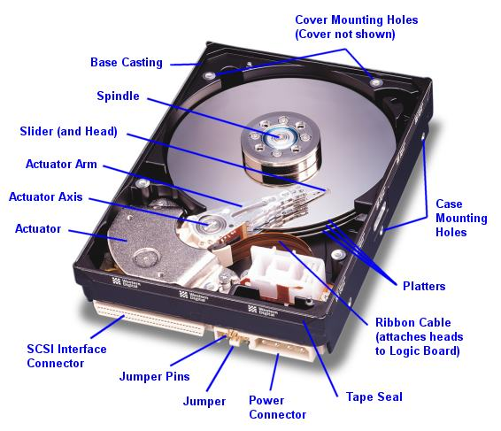
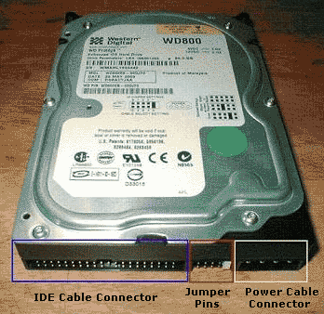
Hard Drive
Hard drives can be auto-detected by most systems if the IDE setting is set to Auto.

Slide 9
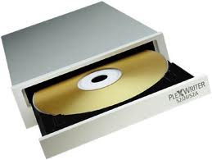
Optical Drive
Optical drives, such as CD, CD-R, CD-RW and DVD players can even set the computer to boot from one of these drives if desired.

Slide 10
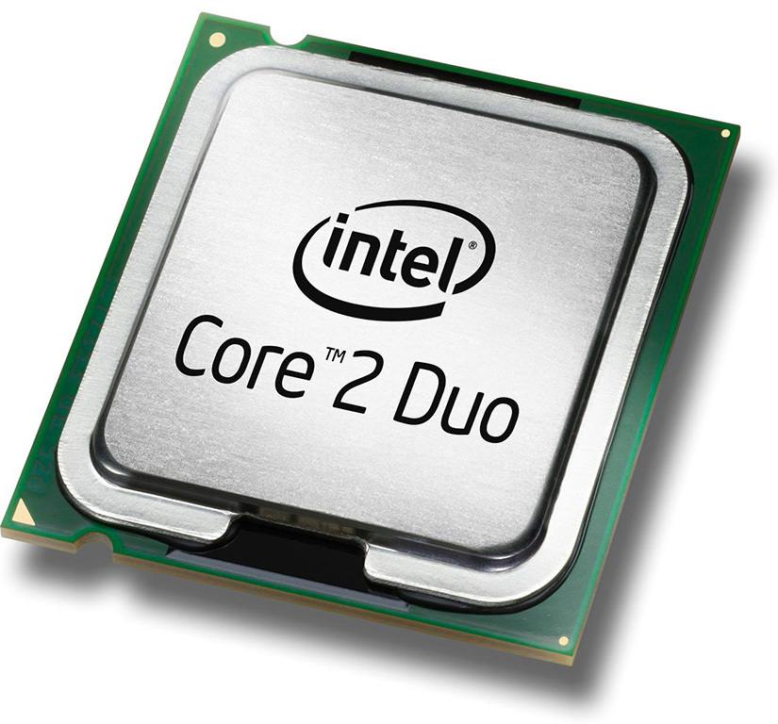
Microprocessor
A microprocessor, sometimes called a logic chip, is a computer processor on a microchip.

Slide 11
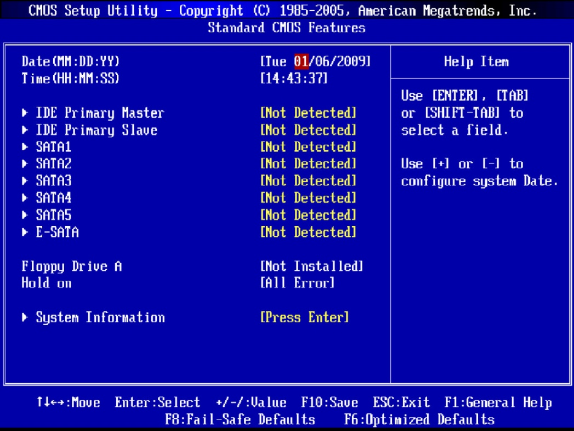
BIOS Configuration
On the screen, you should see which key you need to press to enter Setup. Usually it is Del, F1, F2 or F12
.

Slide 12
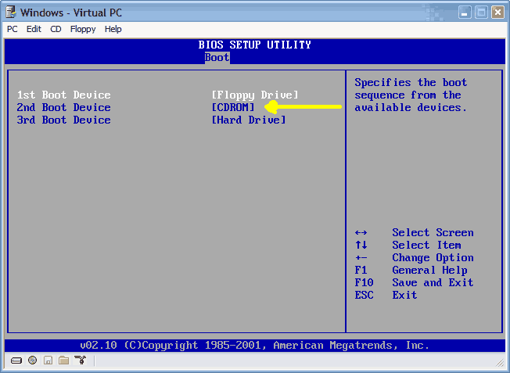
Boot Sequence
You can change the boot sequence by clicking “Boot Sequence” or “Boot Priority Order” or “Boot Device Priority”.

Slide 13
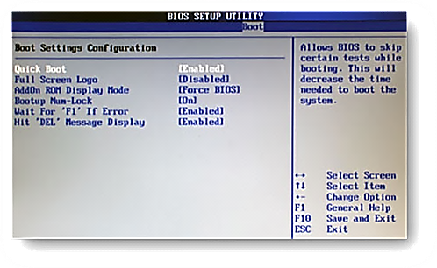
Enable the Quick Boot option
In the past, computers needed to run POSTs – power-on self tests Follow the on-screen instructions to either enable “Quick Boot” or disable “Memory Check”.

Slide 14
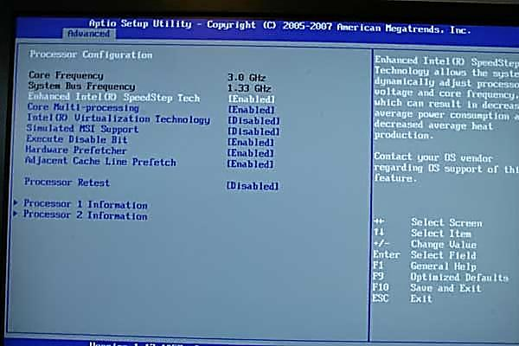
Virtualization support
Using hardware-assisted virtualization allows the hypervisor to dynamically allocate memory and CPU to the VMs as required, you must ensure that it is enabled.

Slide 15
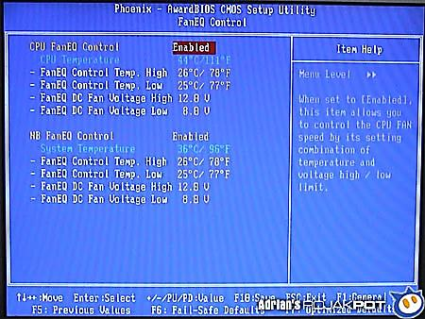
Temperature monitoring
Fan Speeds - The speed at which various fans are operating can also be displayed in the BIOS.

Slide 16
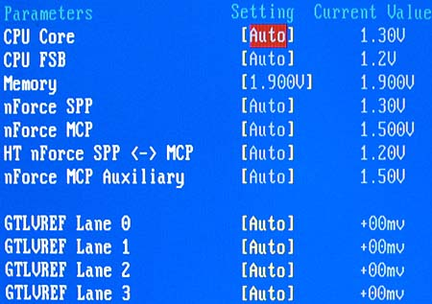
Voltage
Voltage –can monitor and change the voltage settings in the BIOS. Be cautious in changing these settings, as improper settings can damage the system or shorten the life of the CPU.

Slide 17
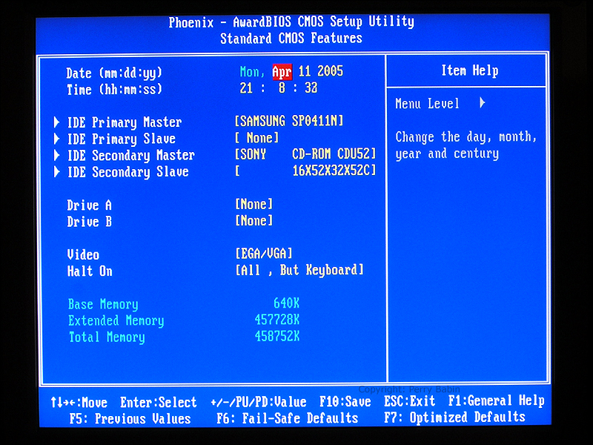
Clock
Clock – The CMOS clock is located on the computer’s motherboard and keeps time when the computer is off

Slide 18
PC Hardware Components
The major hardware components of a microcomputer system, which are used for input, output, processing, storage, electrical supply, and communication
Input and Output Devices – Keyboard, Mouse, Touch screen , Scanner, Bar Code Reader , KVM , Microphone, Biometrics, Game Pads , Joystick, Digitizer
Multimedia Devices- Digital Cameras, Webcam, MIDI enabled Devices, Camcorder
Output Devices- Printers, Speakers, Display Devices
Back panel ports

Slide 19
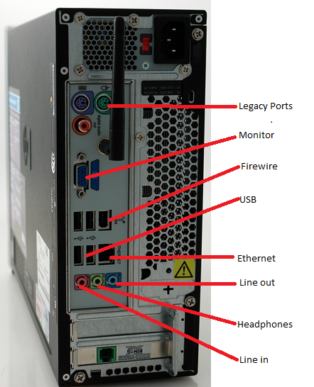
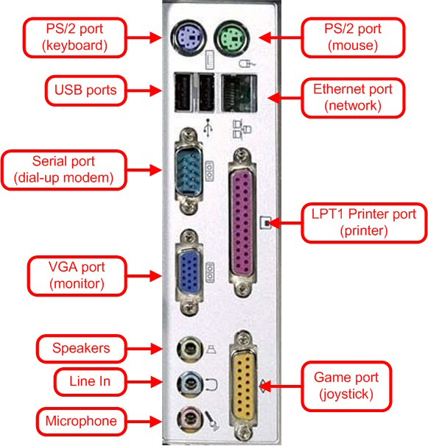
Back panel ports
The figure shows the most common connectors used for a monitor, printer, keyboard,speakers and Mouse.

Slide 20
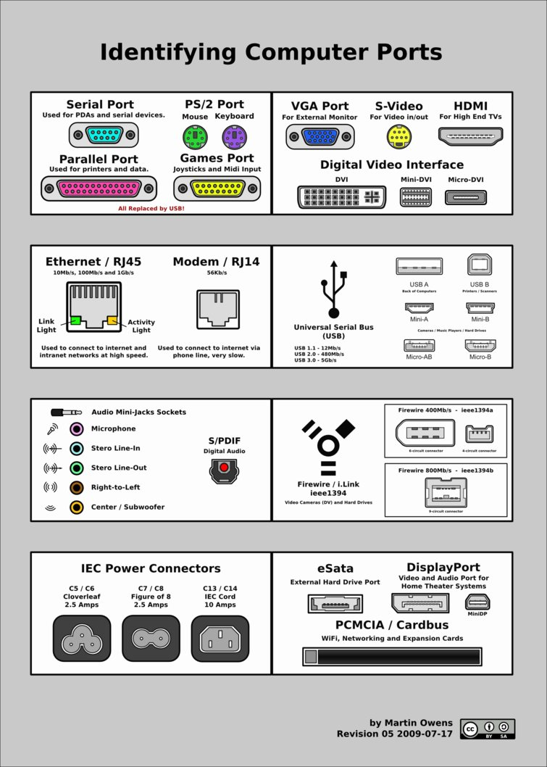
Ports

Slide 21
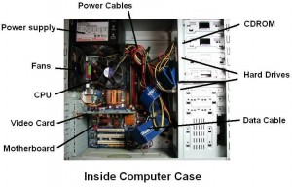
Hardware inside a Computer Case
Most computers contain these devices inside the case
A motherboard containing the CPU, memory, and other components
A hard drive & optical drive (CD/ DVD) used for permanent storage
A power supply with power cords supplying electricity to all devices
Adapter cards used by the CPU to communicate with devices
Cables connecting devices to adapter cards and the motherboard

Slide 22
Custom configuration
User can assemble a PC according to his need and usability
  Graphic/ Cad/ CAM Workstations
    Powerful Processor
    High –End Video Quality
    RAM maximization
  Audio/ Video editing Workstations
  Dual Monitor
  Specialized Audio and Video card
  Specialized Hard drive
  Virtualization Workstations

Slide 23
Custom configuration
  Gaming PC
    Graphics Card
    Processor
    Better Sound Card
    Enhanced Cooling
  Home theater PC
  Good Surround audio
  HDMI Output
  HTPC compact Form factor
  TV tuner cards
  Thick Client PC and Thin client PC
  Home server PC

Slide 24
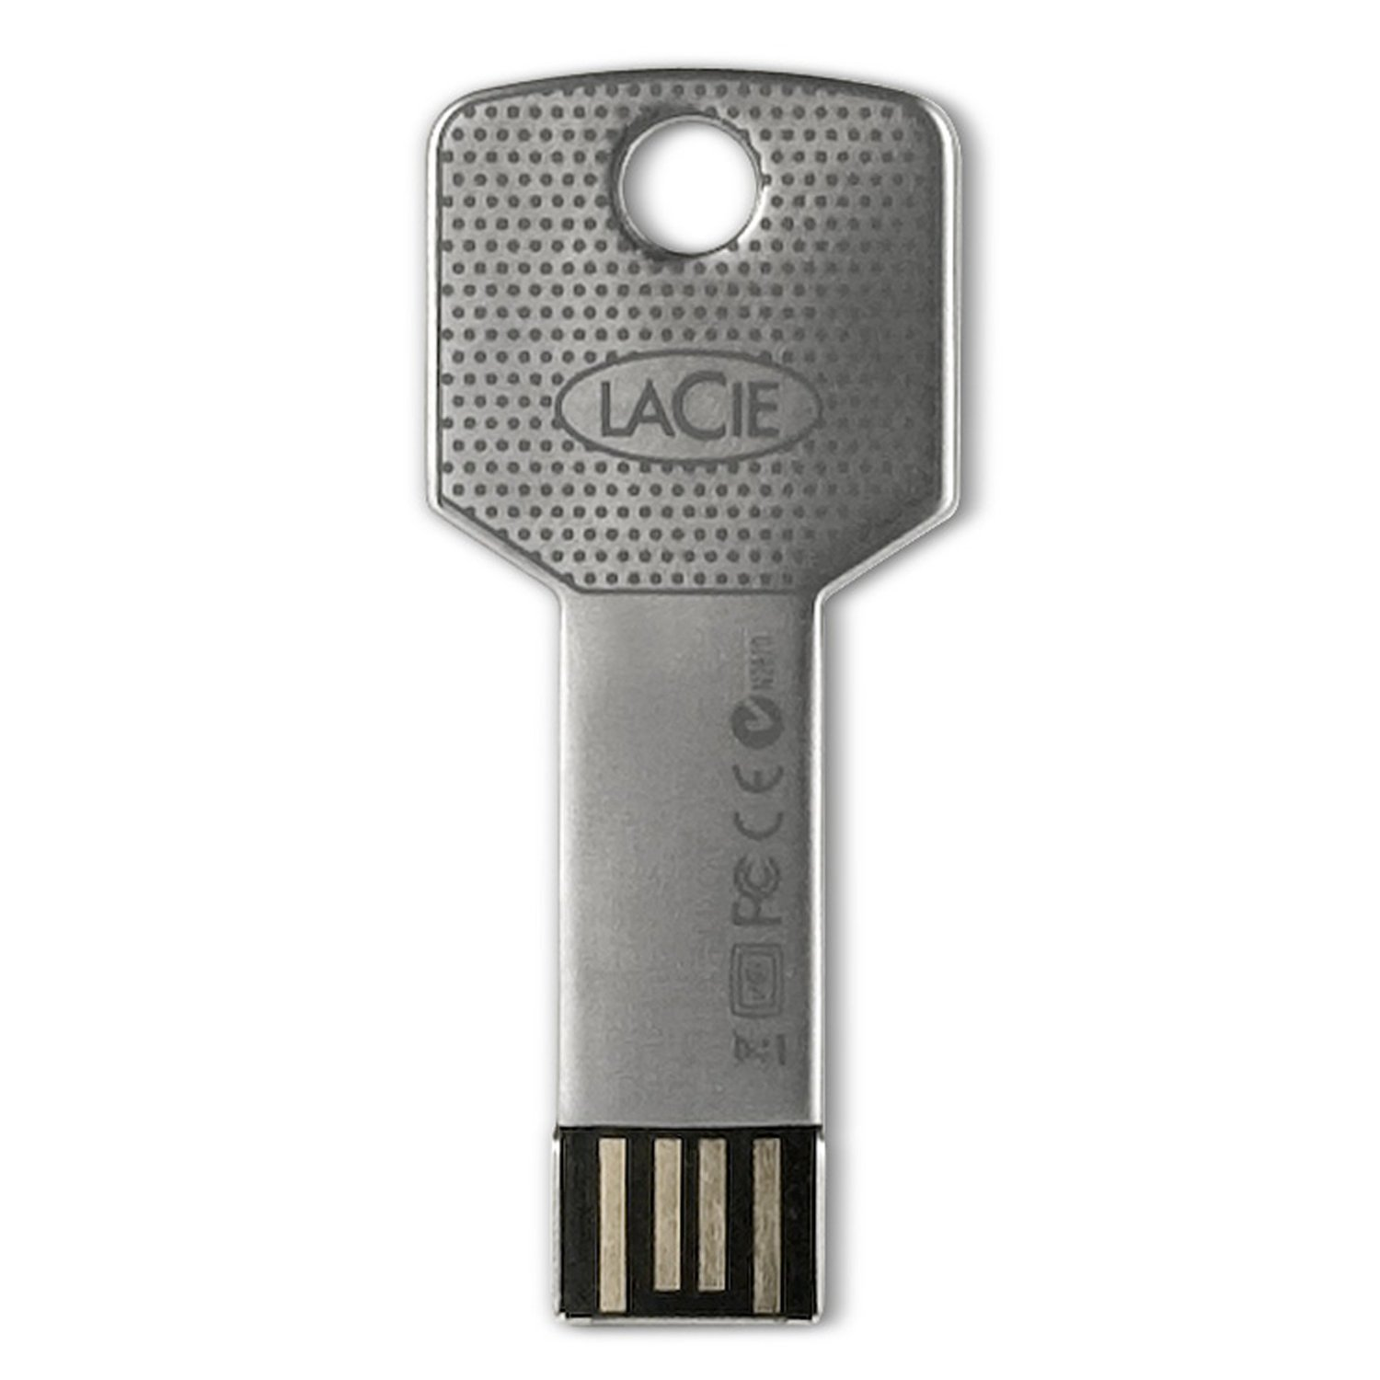
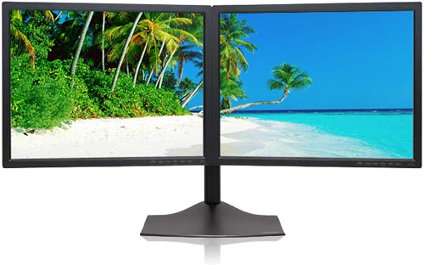
PC System Components
  Dual Monitor
  Specialized Hard drive

Slide 25
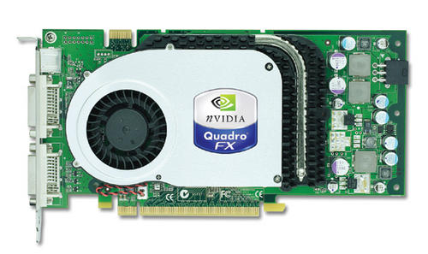
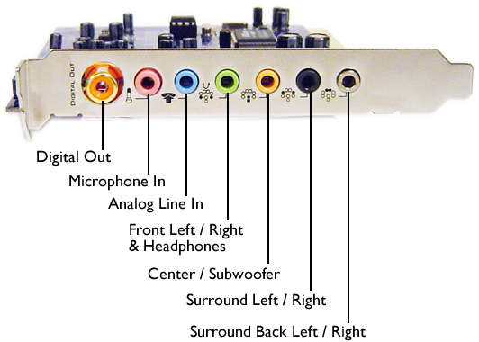
Specialized Audio and Video card

Slide 26
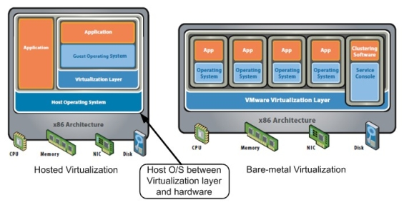
Virtualization Workstations
Virtualization helps us in the purpose of minimizing the hardware footprint required to implement multiple servers and workstations.

Slide 27
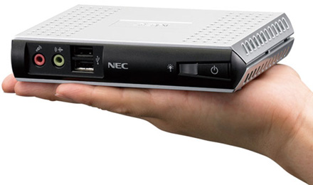
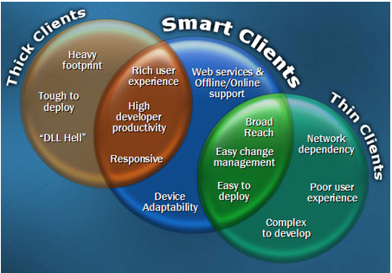
Thick Client PC and Thin client PC
Thin clients use the processing, memory and other resources of a network server to run software applications for users while thick clients use their own resources and run applications locally.

Slide 28
Virtualization Workstations

